Slide 1
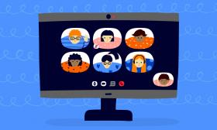
Online class rules for 6th grade

Slide 2
Respect your classmates and teacher! Please do not insult others!

Slide 3
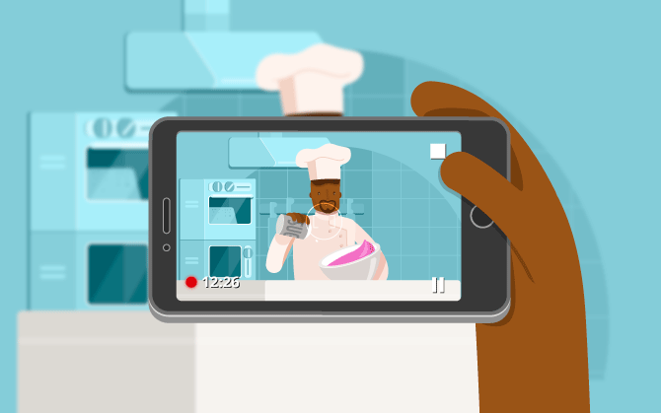
Remember: taking photos and recording are illegal!

Slide 4
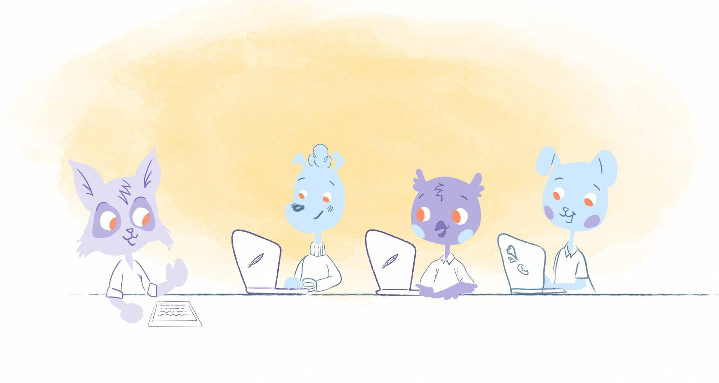
Choose a quiet place to work and make sure you are alone during our meeting! It will be easier for you to listen and participate!

Slide 5
Please keep your mikes closed and wait for your turn to speak!

Slide 6
Ask for help if you have problems (bad Internet connection, speakers or microphone not working)!

Slide 7
Thank you and your parents for your cooperation!

